Slide 1
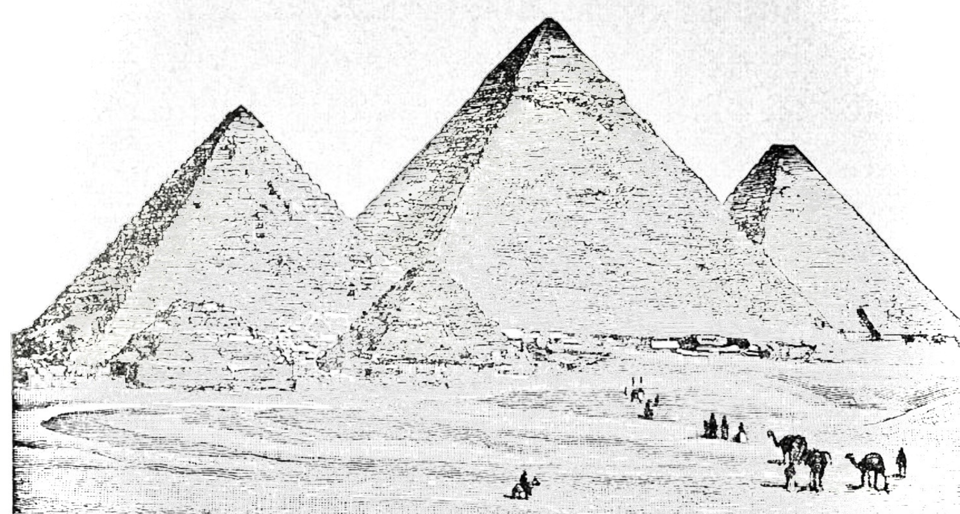
DSO 552 Fall 2021
Class 2 SQL
By Arsames Qajar qajar@usc.edu

Slide 2
SQL Basics Data Definition Language → CREATE, DROP, ALTER the
database and respective tables along with
Data manipulation language using SELECT

Slide 3
Agenda
Finish up DDL SQL clauses (CREATE, ALTER, etc)
Start SQL DML
INSERT
SELECT, FROM, WHERE
Datasets folder here
Assignment #2 on BB due next week

Slide 4
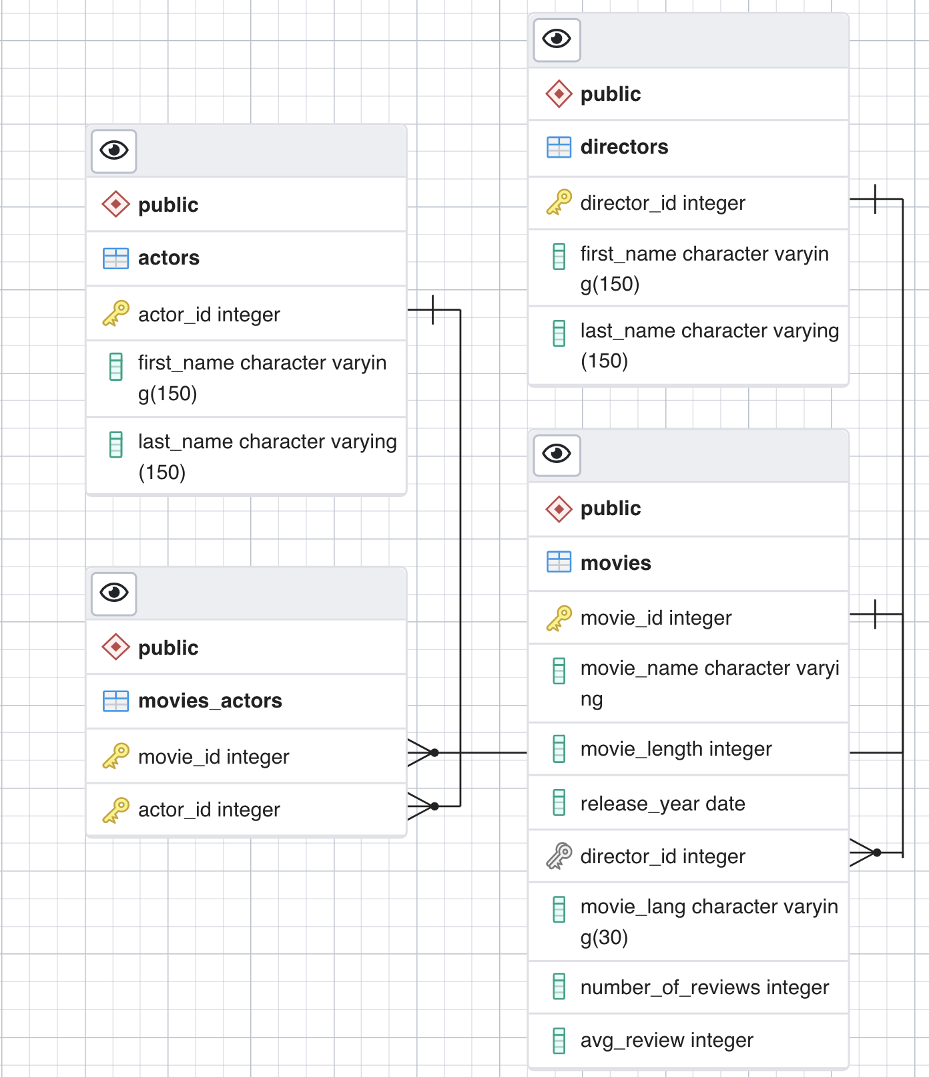
ERD Basics
movie_sample database
Our Schema for our DDL queries
Notes:
Point out data types

Slide 5
Create Table
syntax
CREATE TABLE keyword + IF NOT EXISTS option which avoids error
CREATE TABLE [IF NOT EXISTS] table_name (
col_1 datatype(length) column_contraint,
price NUMERIC NOT NULL CHECK(price>0), table2_id integer REFERENCES table2 (table2_id),
table3_id integer REFERENCES table3 (table3_id),
UNIQUE (col_x), CONSTRAINT constraint_name PRIMARY KEY (col_x,...),
CONSTRAINT composite_pk PRIMARY KEY (table2_id, table3_id)
CONSTRAINT constraint_name FOREIGN KEY (col_y)
REFERENCES table ON UPDATE/DELETE [ON UPDATE CASCADE| SET NULL| SET DEFAULT| NO ACTION]
[ON DELETE CASCADE| SET NULL| SET DEFAULT| NO ACTION], ...
CHECK (condition)
);
Columns have: name, datatype, and constraint
Table constraints including primary key, foreign key, and check constraints.
CONSTRAINT constraint_name is optional

Slide 6
Data Types
Quick Review
Data Type | Definition
BOOLEAN | TRUE or FALSE
CHAR / VARCHAR / TEXT | fixed/ variable / no limit
DECIMAL/ NUMERIC | When exact precision is needed e.g. financial data. Numeric also used for monetary data.
BIGINT / INT/ SMALLINT / TINYINT | 19 digits / 10 digits
FLOAT/ DOUBLE PRECISION | Approximate! When exact precision not needed
MONEY | Not good for currency conversions, use numeric.
DATE, *TIME, TIMESTAMP *can set with timezone* | “YYYY-MM-DD”, “HH:MI:SS”, “YYYY-MM-DD HH:MI:SS”
Most numeric types are one of the following:
Exact (SMALLINT, INTEGER, BIGINT, NUMERIC(p,s), and DECIMAL(p,s))
Approximate (FLOAT(p), REAL, and DOUBLE PRECISION)
MOST USED Data types
Integer
Numeric
Text
Date
Time
Timestamp
Integer is the most used for numeric data types
Numeric for precision, but slow computation compared to integer & double precision
Notes:
integer for whole numbers, numeric for possibly fractional numbers, text for character strings, date for dates, time for time-of-day values, and timestamp

Slide 7
Constraints
Domain Constraints
NOT NULL
CHECK(condition) to ensure a column meets some parameters e.g. CHECK(price >-1, column1 IS NOT NULL)
Referential Integrity Constraints i.e. Foreign Key
NO ACTION - if parent table receives an update/delete query, error is raised & action is rollbacked i.e. leave blank
CASCADE - updates/deletes to rows in parent affect corresponding rows in child table
SET NULL - sets corresponding rows in child table to NULL
Entity Constraints
PRIMARY KEY(col_x, …) must be a unique non-NULL value for each row. Could be more than one column
UNIQUE (col_y) ensures other columns are unique e.g. email

Slide 8
SQL DDL ALTER TABLE syntax
To modify an existing table, use the following: ALTER TABLE table_name action; note : [...] refers to alter table movies
Action | Example
Add a column | ALTER TABLE movies ADD COLUMN subtitle VARCHAR(20);
Drop a column | ALTER TABLE movies DROP COLUMN subtitle;
Change the data type of a column | [...] ALTER COLUMN movie_length TYPE VARCHAR;
Rename a column | [...] RENAME COLUMN movie_length TO m_length;
Add a constraint to a column | [...] ADD CONSTRAINT longer_movies CHECK(movie_length>0);
Rename a table | [...] ADD COLUMN subtitle VARCHAR(20)
Notes:
https://www.postgresql.org/docs/current/catalog-pg-type.html
pg_type from the system catalog

Slide 9
SQL Basics - DML Data Manipulation Language → SELECT, Sorting information and
other clauses to transform our data

Slide 10
Outline
If you haven't, please download here
Intro to DML
Review the INSERT INTO & upload data
SELECT with aliases and expressions
Filtering with the WHERE clause
Logical and Comparison operators

Slide 11
INSERT statement (DML)
Syntax: INSERT INTO table (columnlist)
VALUES
(RowValues1),
(RowValues2)
[repeat any number of times]
Example:
INSERT INTO directors (first_name,last_name) VALUES
('Bill','O''Sullivan'),
('Paul','Anderson') RETURNING *;
Note
(Columnlist) can be any or all of the fields within the table
Data values on insert should be the right format
If a name has an apostrophe e.g. O’Sullivan, add an extra single quote
RETURNING: Specify any or all(*) of the fields used in the
INSERT INTO statement

Slide 12
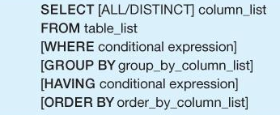
SELECT statement (DML)
Notes:
DDL – Data Definition Language DQl – Data Query Language DML – Data Manipulation Language DCL – Data Control Language

Slide 13
SELECT all columns
Syntax
SELECT *
FROM table
Example
SELECT *
FROM movies

Slide 14
SELECT columns & alias
Syntax
SELECT column1, column2 as newName
FROM table
Example
SELECT movie_name, movie_length as “MovieLength”
FROM movies

Slide 15
SELECT & ORDER BY
Syntax
SELECT column1, column2
FROM movies
ORDER BY columnX [ASC | DESC], columnY [ASC | DESC]
ASC = ascending order (default)
DESC = descending order

Slide 16
SELECT ,ORDER BY, LIMIT
Limiting number of results not to overload database
SELECT columns… FROM table LIMIT # of records needed
DISTINCT keyword must be applied to remove duplicates in results
Example
SELECT distinct movie_lang
FROM movies
ORDER BY movie_lang [ASC | DESC]
LIMIT 3

Slide 17
WHERE clause (DML)
Syntax:
SELECT select_list
FROM table_name
WHERE condition
ORDER BY sort_expression
Column conditions that filter/specify which rows should be returned
The conditions in the WHERE clause use operators: comparison, arithmetic, logical operators
Any column aliases in the SELECT clause cannot be used in the WHERE clause

Slide 18
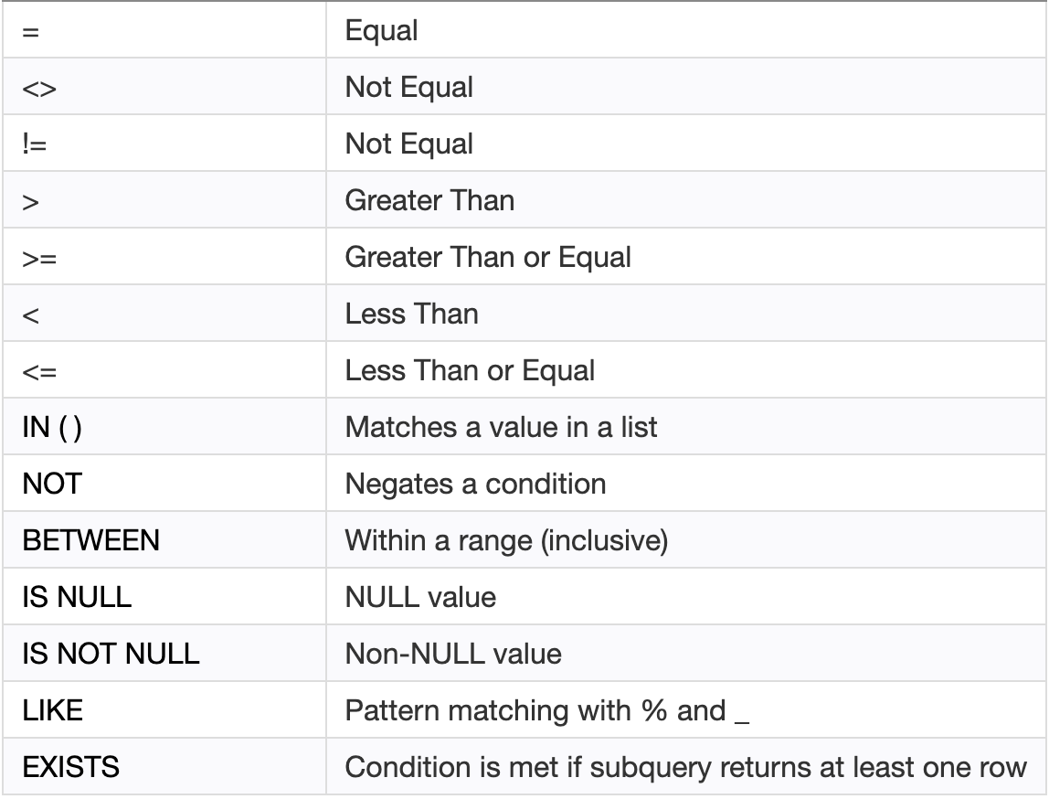
Comparison Operators
Compare a column value to another column
value or value of the same datatype
Example:
SELECT *
FROM movies
WHERE movie_length BETWEEN 50 AND 120
Also…
SELECT *
FROM movies
WHERE movie_length >=50 AND
movie_length<=120
Notes:
https://www.techonthenet.com/postgresql/comparison_operators.php

Slide 19
Logical Operators
AND = if both boolean expressions are true then it will return TRUE
OR = if any boolean expression is true then it will return TRUE
NOT = Reverses the value of Boolean operator
Example
SELECT *
FROM movies
WHERE movie_length > 50 AND movie_lang = ‘English’

Slide 20
Extra….

Slide 21
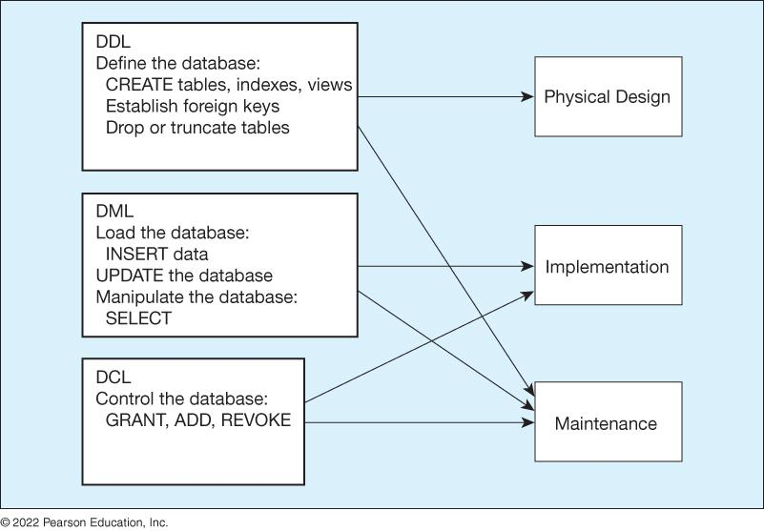
SQL: DML, DDL et al.

Slide 22
Links/Resources
Postgresql create table
Copy data from file
Data Types & explanations:
Data types documentation, and this and this
Numeric data types here
Tables & data types review (AWS)
PRIMARY KEY constraint
Table & column constraints
Create Table
Alter Table
Psql shell commands

Slide 23
Postgres Data Types Data types documentation
BOOLEAN TRUE or FALSE
CHAR Fixed length string (padded with blanks) e.g. CHAR(10)
VARCHAR Variable length string e.g. VARCHAR(50)
BIT Bit string e.g. BIT(4) can store '0101'
NUMERIC or Exact numeric data type e.g. NUMERIC(7,2) = 7 digits, 2 decimal places
DECIMAL
INTEGER Integer data only
SMALLINT Smaller space than INTEGER
FLOAT or Approximate numeric data types.
REAL
DATE Stores YEAR, MONTH, DAY (“YYYY-MM-DD”)
TIME Stores HOUR, MINUTE, SECOND (‘hh:mm:ss[.f] ' e.g. '15:00:00')
TIMESTAMP Stores date and time data. (‘YYYY-MM-DD hh:mm:ss[.f] ' e.g. ‘1975-05-17 15:00:00')
INTERVAL Time interval.
CHARACTER Stores a character array (e.g. for a document) LARGE OBJECT
BINARY LARGE Stores a binary array (e.g. for a picture, movie)
OBJECT

Slide 24
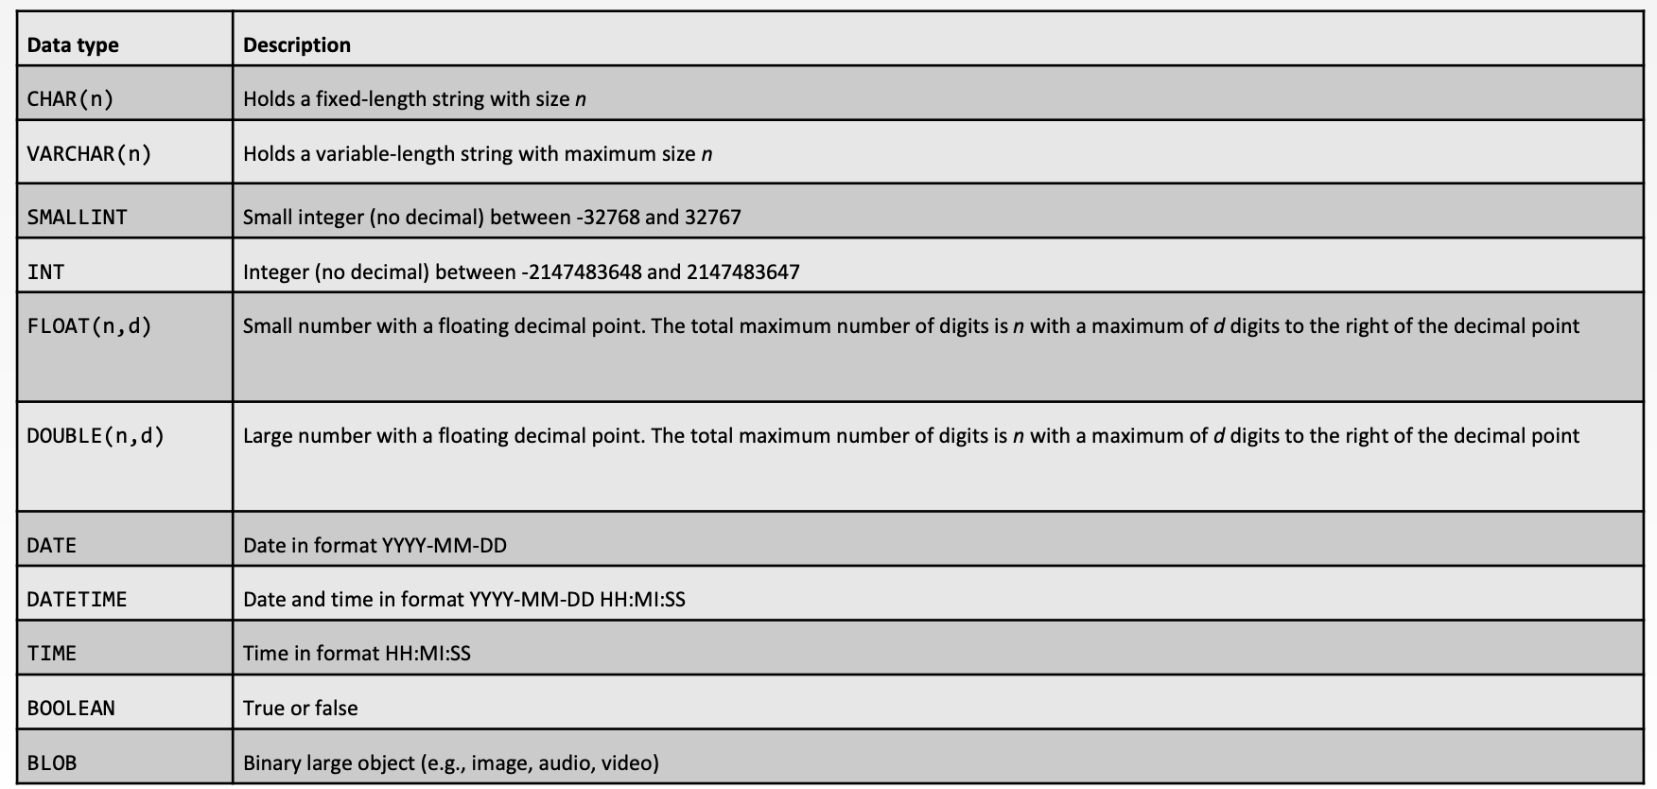
Postgres Data Types Data types documentation

Slide 25
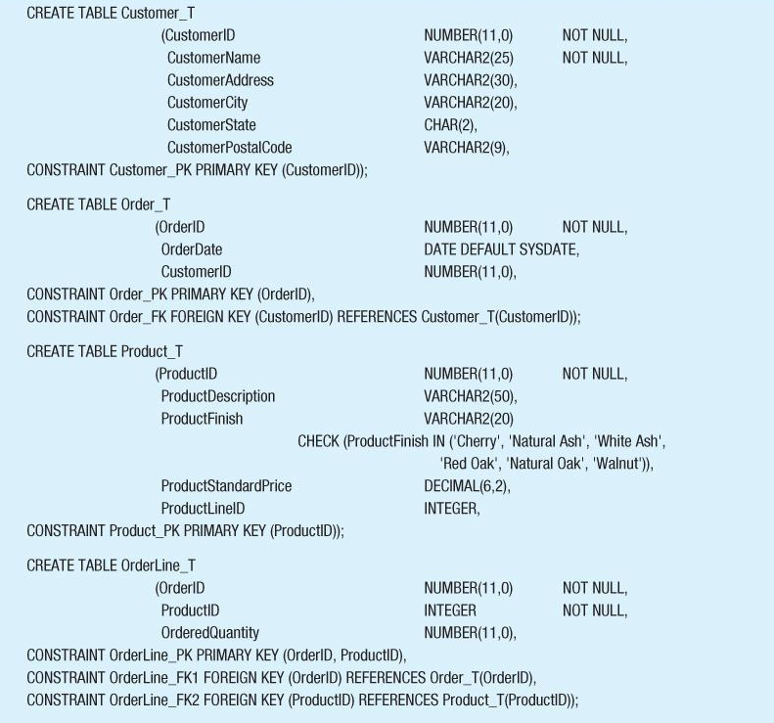
Create Table Example

Slide 26
Database Systems
Schemas how should I organized my data ?
Normalization is there redundant data ?
Views/Stored Procedures what kinds of questions of my data will I ask/require most often?
Access Control should all users of the data have the same level of access?

Slide 27
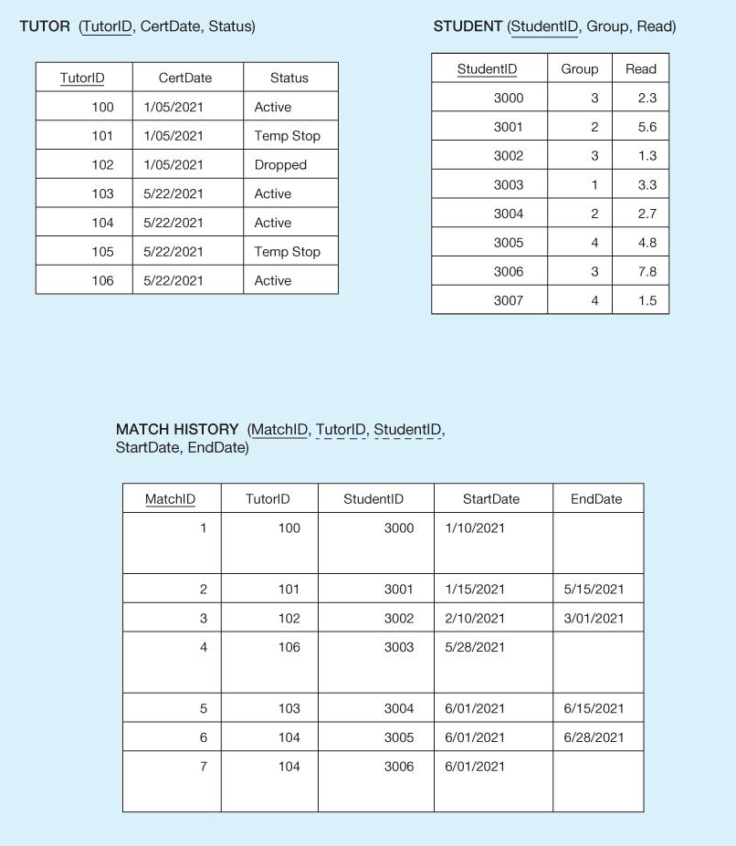
Database Systems Definitions cont’d
Notes:
Chapter 5

Slide 28
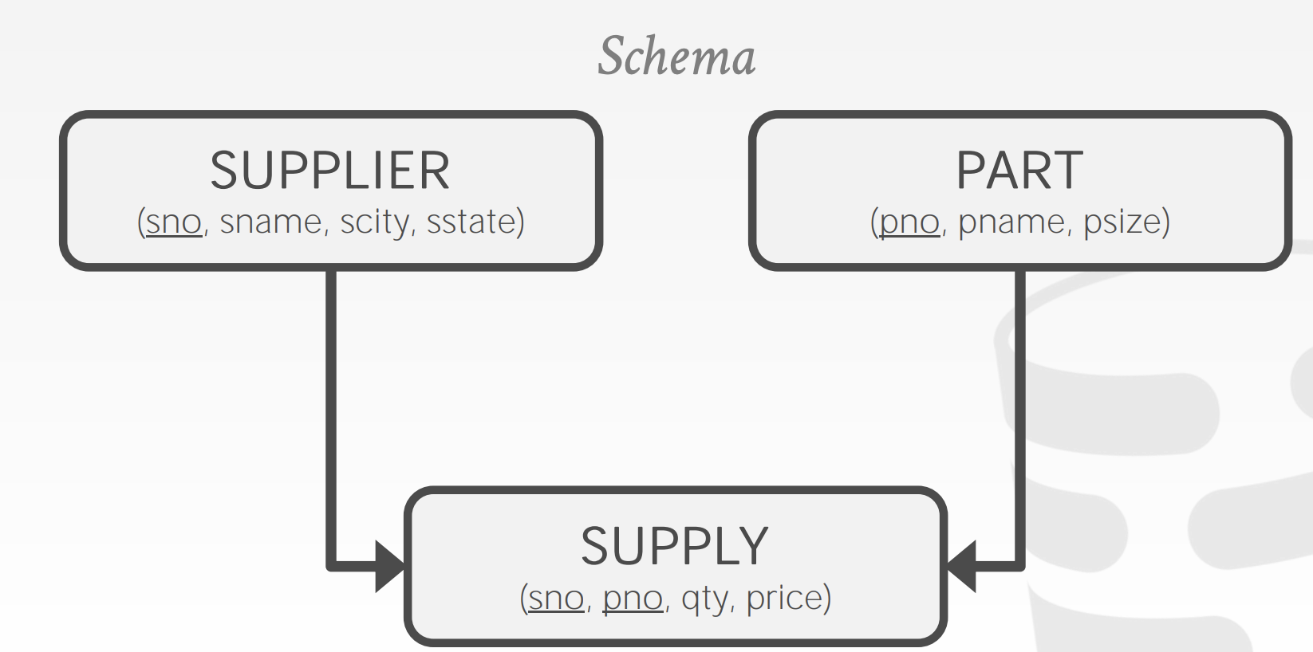
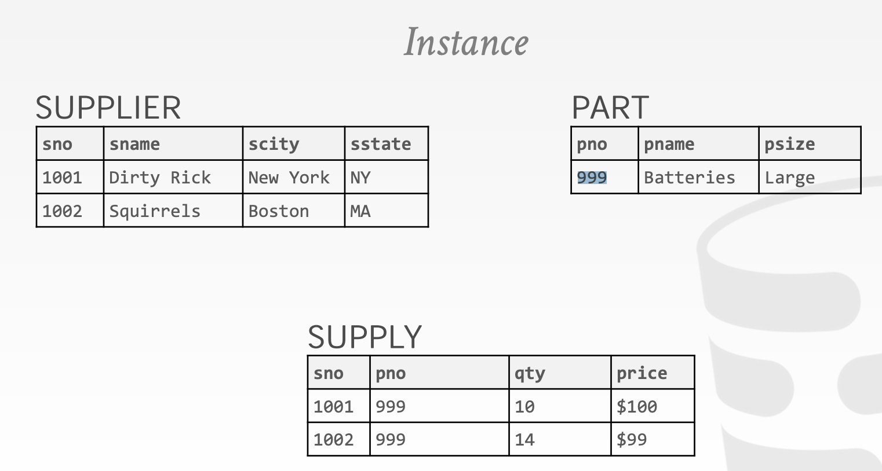
Databases Schemas
Notes:
https://www2.seas.gwu.edu/~bhagiweb/cs2541/lectures/rel-intro.pdf

Slide 29
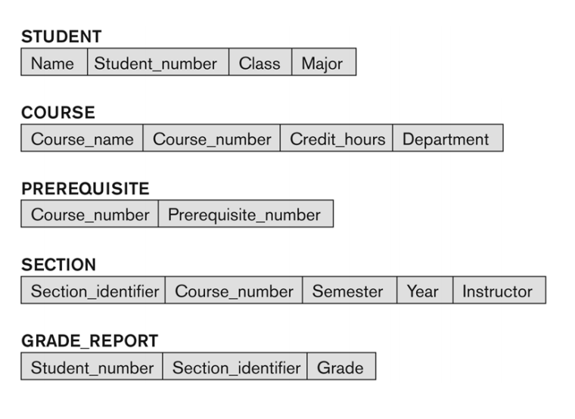
Databases University schemas
Notes:
https://www2.seas.gwu.edu/~bhagiweb/cs2541/lectures/rel-intro.pdf

Slide 30
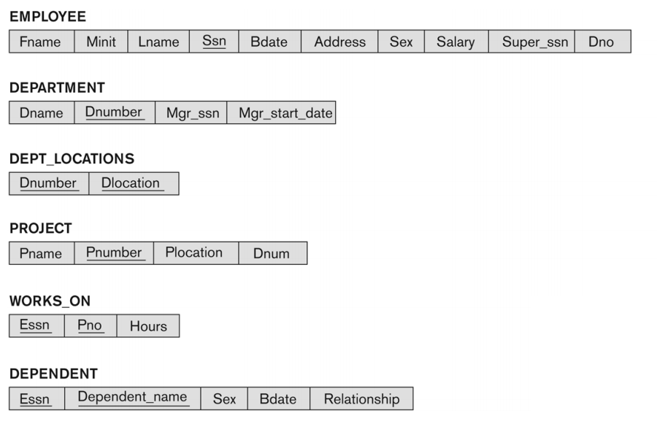
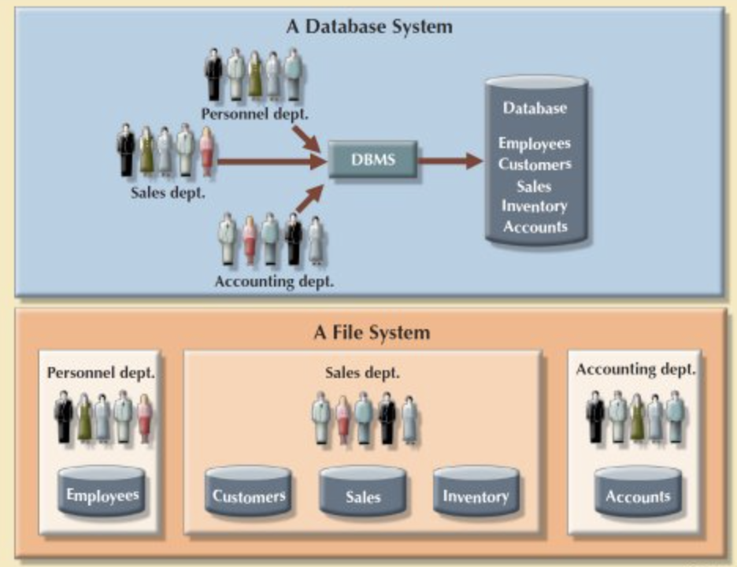
Databases Company schemas
Notes:
https://www2.seas.gwu.edu/~bhagiweb/cs2541/lectures/rel-intro.pdf

Slide 31
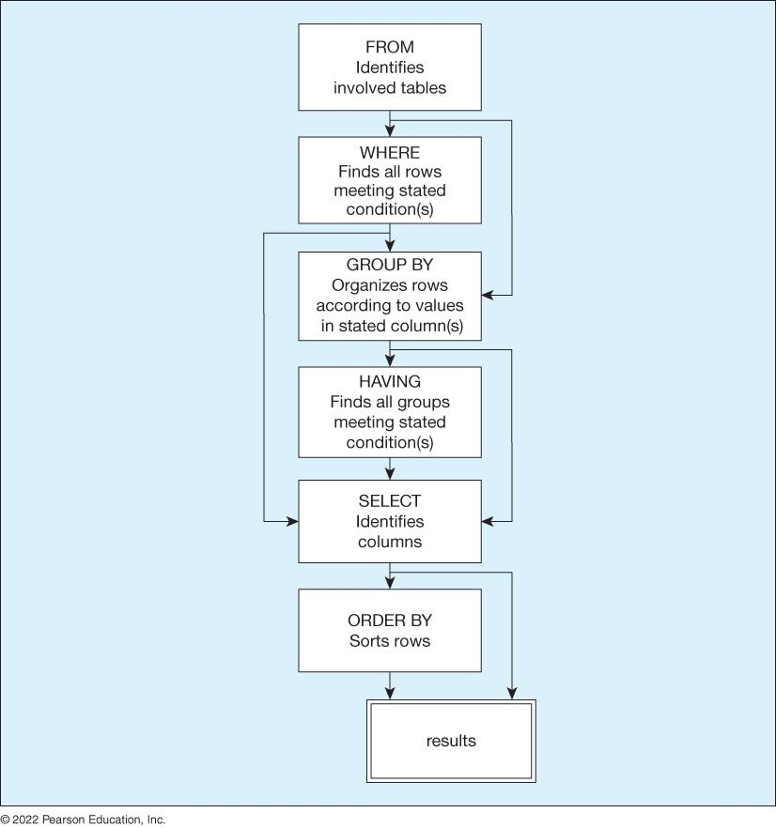
SQL How SQL processes your query
Notes:
https://www.czobel.bit.vt.edu/bit4514/handouts/lecture%2001.pdf p.4
Database vs excel https://365datascience.com/tutorials/sql-tutorials/database-vs-spreadsheet/
https://courses.cs.duke.edu//fall12/compsci316/lectures/01-intro-notes.pdf

Slide 32
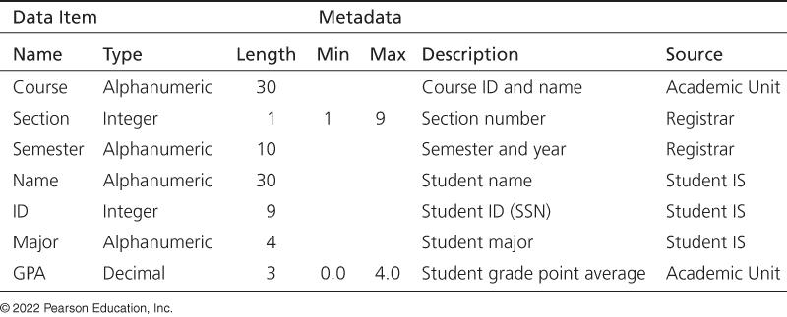
Metadata example
Notes:
Why is this a bad definition

Slide 33
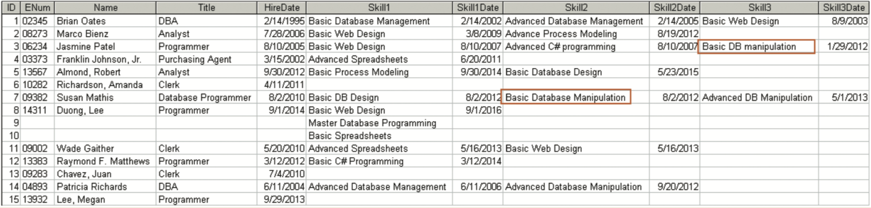
Databases File vs Database
Notes:
Why is this a bad definition

Slide 34
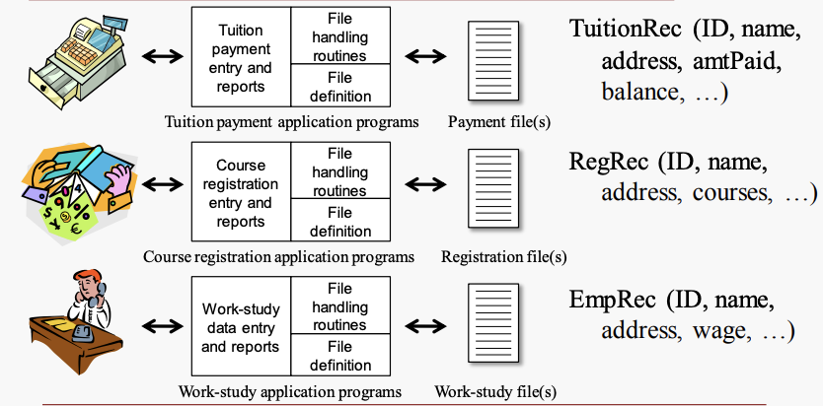
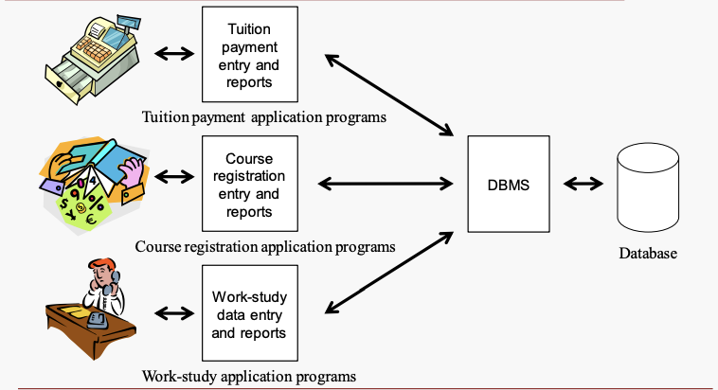
Databases File vs Database
Excel i.e. flat file system
Database
Notes:
https://www.czobel.bit.vt.edu/bit4514/handouts/lecture%2001.pdf p.4
Database vs excel https://365datascience.com/tutorials/sql-tutorials/database-vs-spreadsheet/
https://courses.cs.duke.edu//fall12/compsci316/lectures/01-intro-notes.pdf

Slide 35
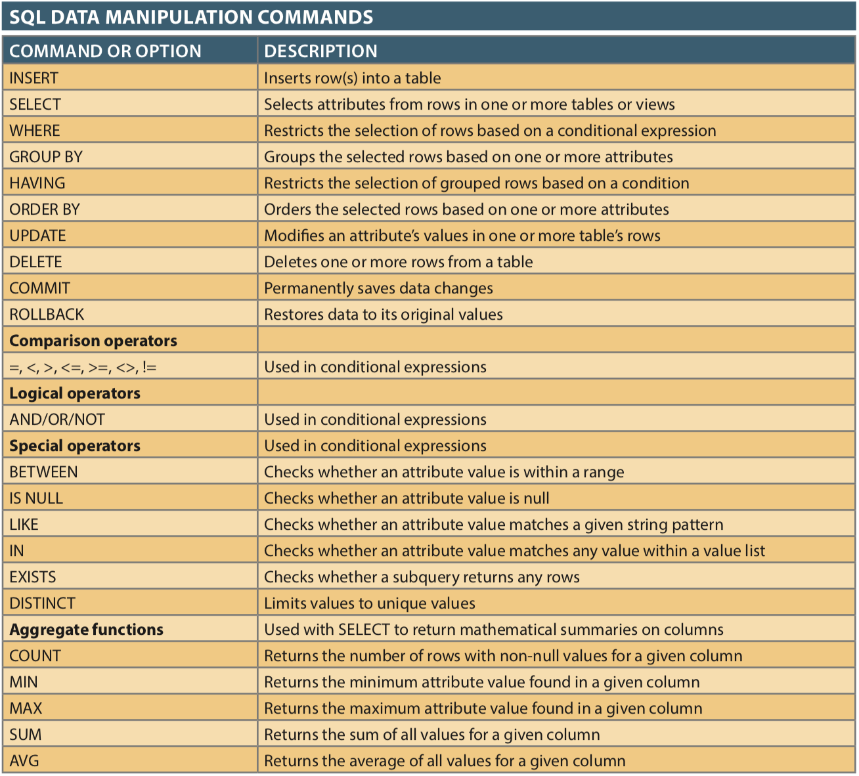
SQL Basics

Slide 36
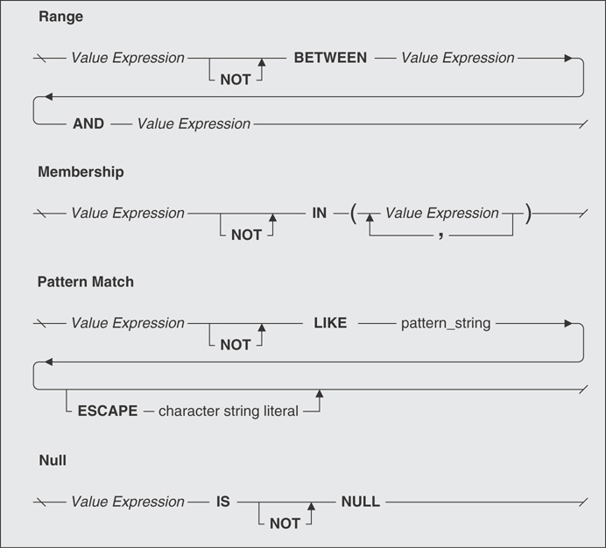
Logical Operator - NOT

Slide 37
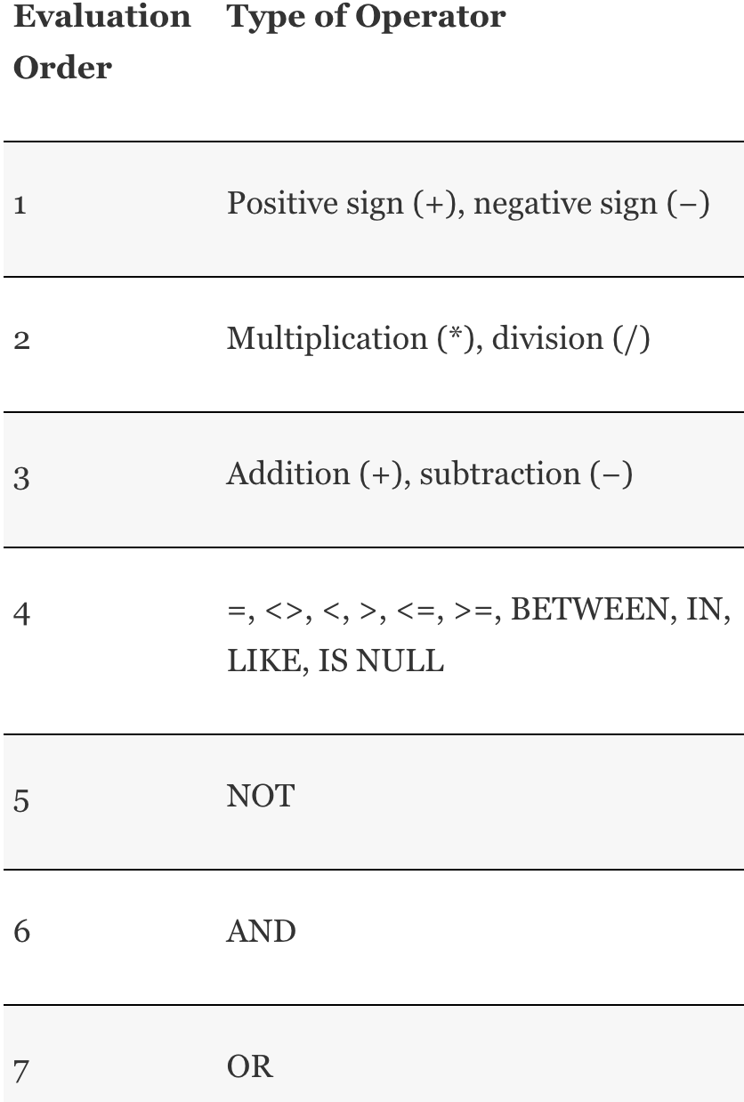
Orders of Precedence

